Slide 1
Unit 3

Slide 2
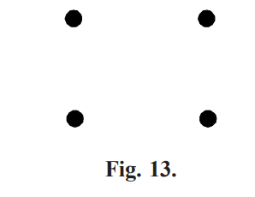
TYPES OF GRAPHS
Null graph A graph which contains only isolated node, is called a null graph. i.e., the set of edges in a null graph is empty.
Null graph is denoted on n vertices by Nn N4 is shown in Figure (13), Note that each vertex of a null graph is isolated

Slide 3
Complete graph
A simple graph G is said to be complete if every vertex in G is connected with every other vertex. i.e., if G contains exactly one edge between each pair of distinct vertices.
A comple graph is usually denoted by Kn. It should be noted that Kn has exactly ( 1) 2 n n – edges.
The graphs Kn for n = 1, 2, 3, 4, 5, 6 are show in Figure 14

Slide 4
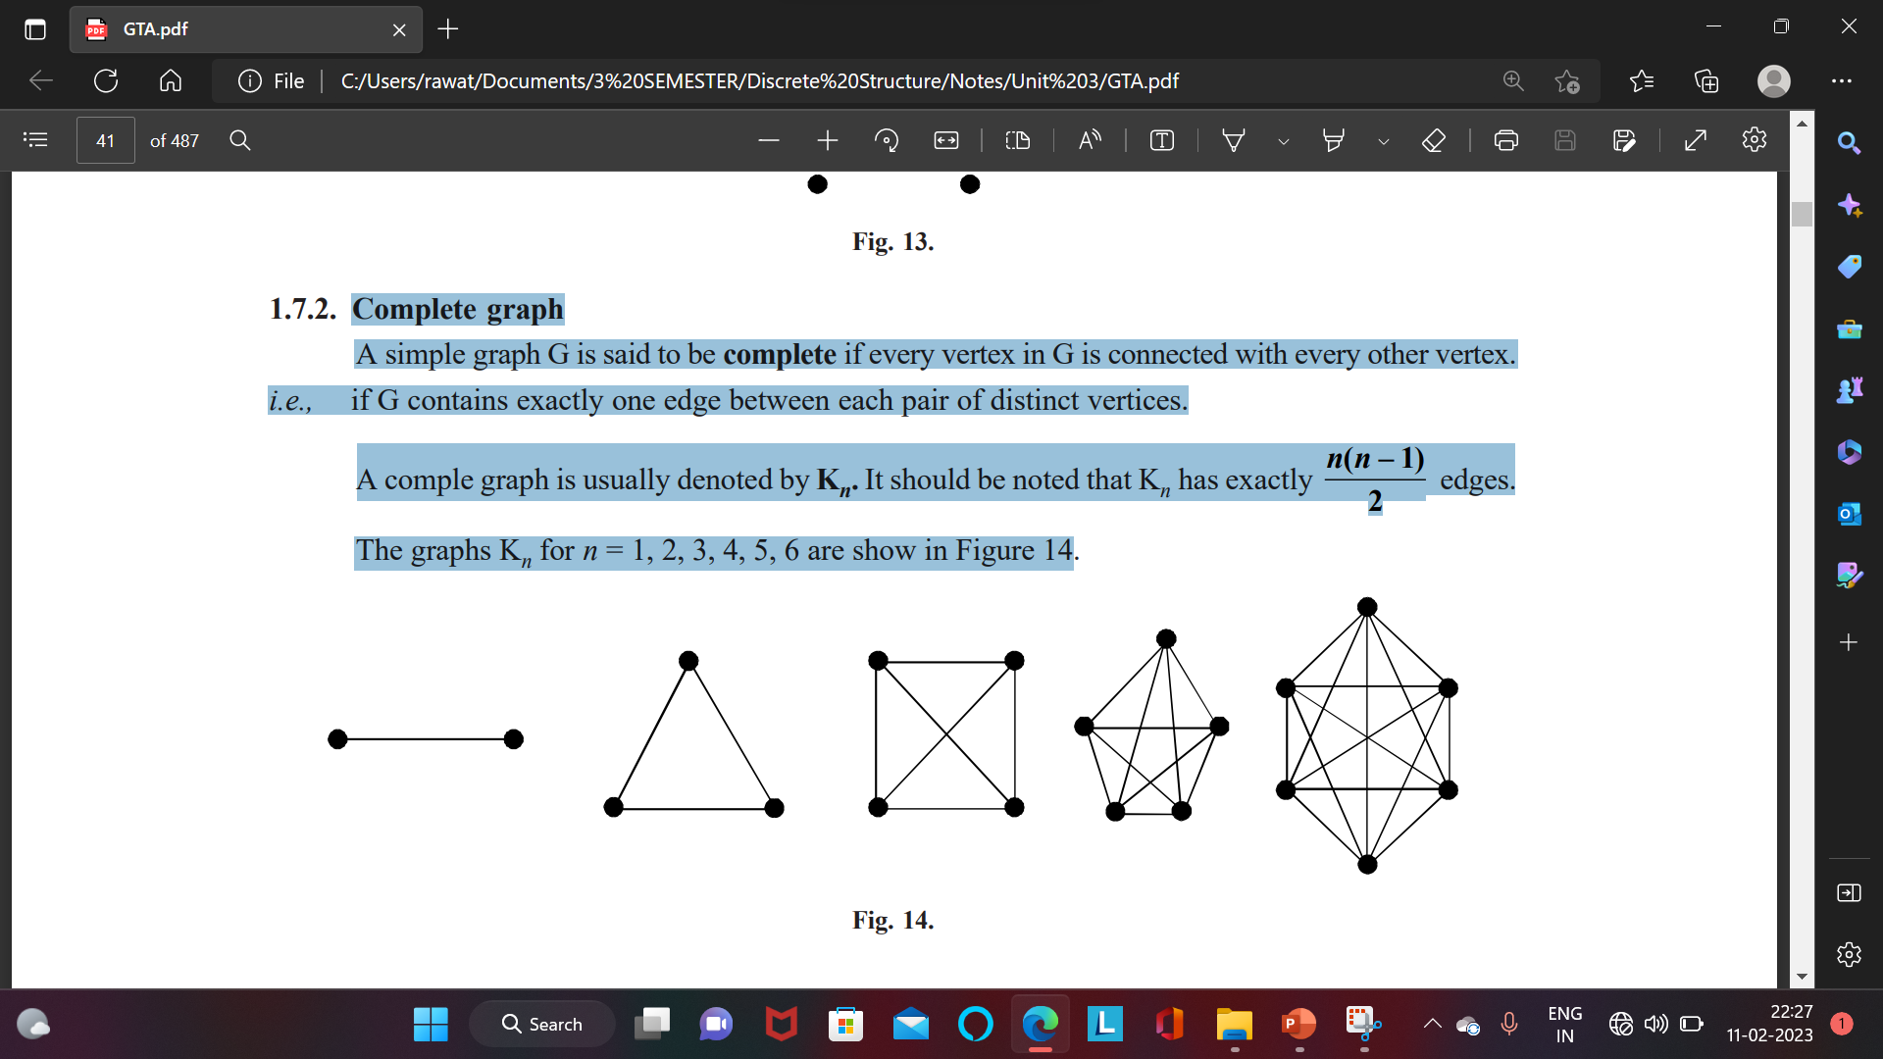

Slide 5
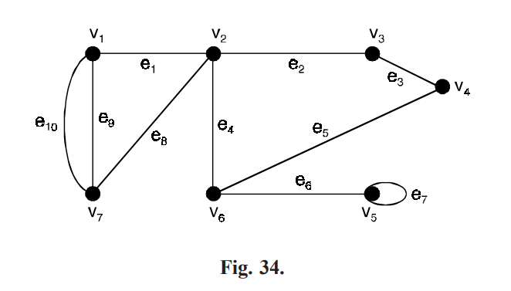

Slide 6
GRAPHS ISOMORPHISM
Let G1 = (v1, E1) and G2 = (v2, E2) be two graphs.
A function f : v1 → v1 is called a graphs isomorphism if
(i) f is one-to-one and onto.
(ii) for all a, b ∈ v1, {a, b} ∈ E1 if and only if {f(a), f(b)} ∈ E2 when such a function exists, G1 and G2 are called isomorphic graphs and is written as G1 ≅ G2.
In other words, two graphs G1 and G2 are said to be isomorphic to each other if there is a oneto-one correspondence between their vertices and between edges such that incidence relationship is preserve.
Written as G1 ≅ G2 or G1 = G2.

Slide 7
GRAPHS ISOMORPHISM
The necessary conditions for two graphs to be isomorphic are
1. Both must have the same number of vertices
2. Both must have the same number of edges
3. Both must have equal number of vertices with the same degree.
4. They must have the same degree sequence and same cycle vector (c1, ......, cn), where ci is the number of cycles of length i.

Slide 8
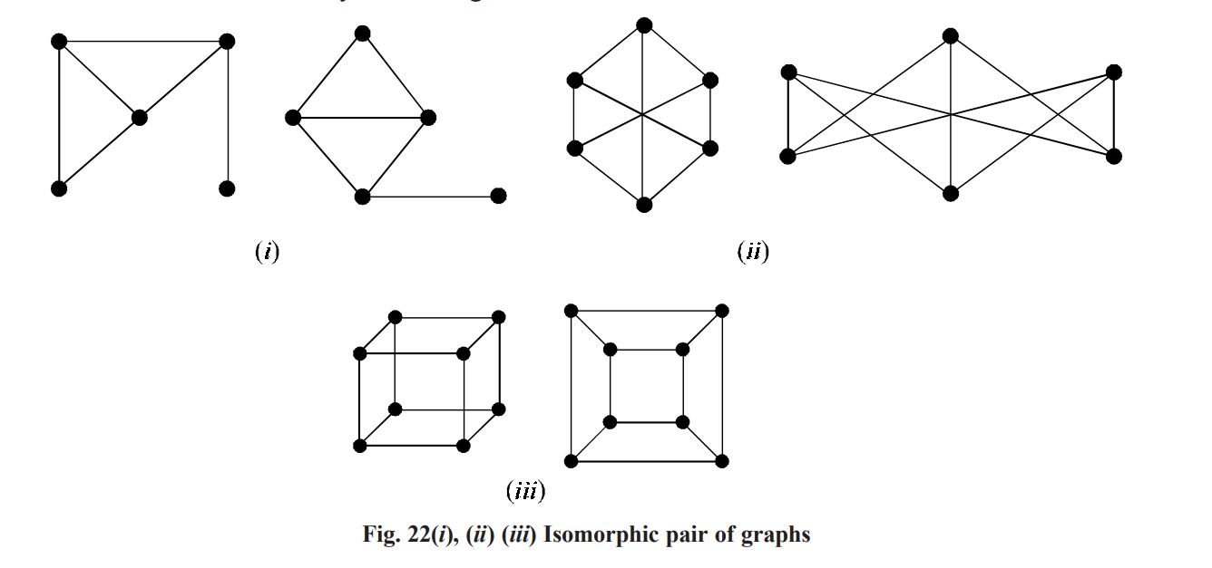

Slide 9
Walk
A walk is defined as a finite alternative sequence of vertices and edges, of the form vi ej , vi + 1 ej + 1, vi + 2, ......., ekvm which begins and ends with vertices, such that
(i) each edge in the sequence is incident on the vertices preceding and following it in the sequence.
(ii) no edge appears more than once in the sequence, such a sequence is called a walk or a trial in G. For example, in the graph shown in Figure 34, the sequences v2e4v6e5v4e3v3 and v1e8v2e4v6e6v5e7v5 are walks

Slide 10
The vertex with which a walk begins is called the initial vertex and the vertex with which a walk ends is called the final vertex of the walk.
The initial vertex and the final vertex are together called terminal vertices.
Non-terminal vertices of a walk are called its internal vertices.
A walk having u as the initial vertex and v as the final vertex is called a walk from u to v or briefly a u – v walk.
A walk that begins and ends at the same vertex is called a closed walk.
In other words, a closed walk is a walk in which the terminal vertices are coincident.
A walk that is not closed is called an open walk. In other words, an open walk is a walk that begins and ends at two different vertices.
In Figure 34. v1e9v7e8v2e1v1 is a closed walk and v5e7v5e6v6e5v4 is an open walk

Slide 11
Path
In a walk, a vertex can appear more than once.
An open walk in which no vertex appears more than once is called a simple path or a path.
For example, in the graph shown in Figure 34.
v6e5v4e3v3e2v2 is a path whereas v5e7v5e6v6 is an open walk but not a path

Slide 12
Circuit
A closed walk with atleast one edge in which no vertex except the terminal vertices appears more than once is called a circuit or a cycle.
For example, in the graph shown in Figure 34, v1e1v2e8v7e9v1 and v2e4v6e5v4e3v3e2v2 are circuits.
But v1e9v7e8v2e4v6e5v4e3v3e2v2e1v1 is a closed walk but not a circuit.

Slide 13
Notes
(i) In walks, path and circuit, no edge can appears more than once.
(ii) A vertex can appear more than once in a walk but not in a path
(iii) A path is an open walk, but an open walk need not be a path.
(iv) A circuit is a closed walk, but a closed walk need not be a circuit

Slide 14
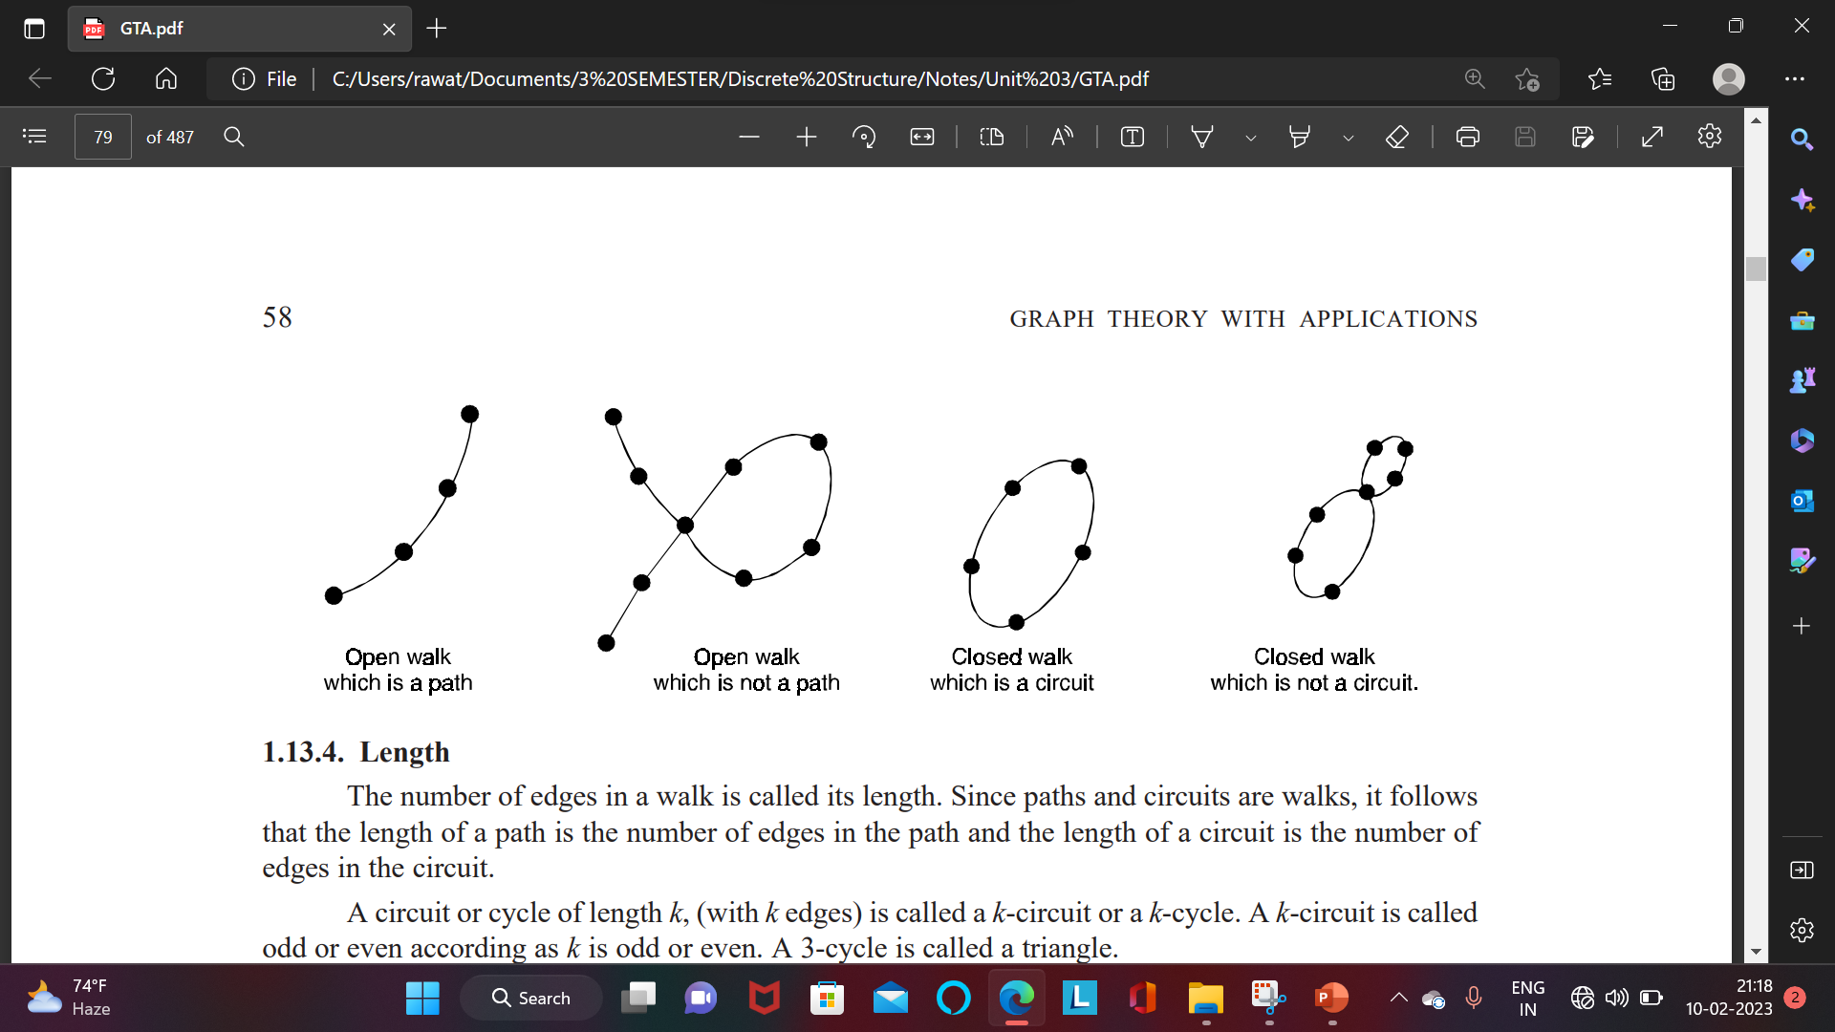

Slide 15
EULERIAN GRAPHS
Euler path A path in a graph G is called Euler path if it includes every edges exactly once.
Since the path contains every edge exactly once, it is also called Euler trail.
Euler circuit An Euler path that is circuit is called Euler circuit. A graph which has a Eulerian circuit is called an Eulerian graph

Slide 16
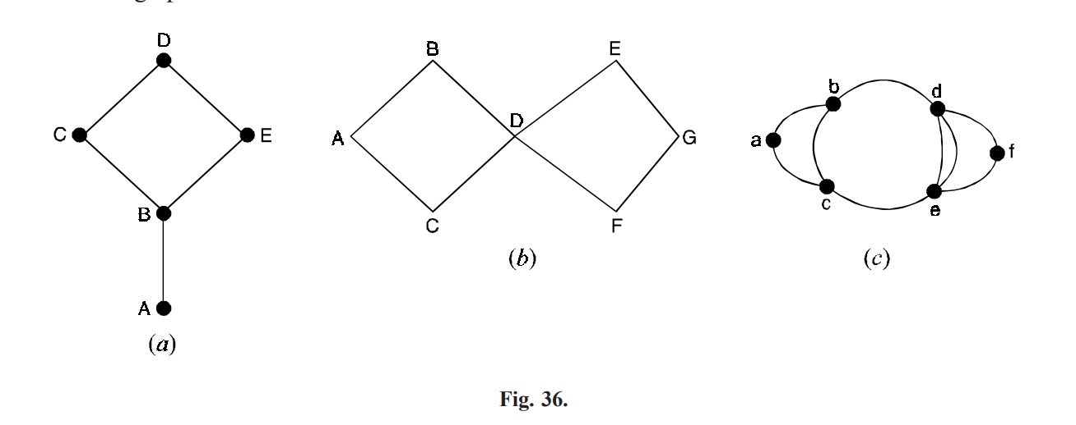
The graph of Figure 36(a) has an Euler path but no Euler circuit. Note that two vertices A and B are of odd degrees 1 and 3 respectively. That means AB can be used to either arrive at vertex A or leave vertex A but not for both. Thus an Euler path can be found if we start either from vertex A or from B. ABCDEB and BCDEBA are two Euler paths. Starting from any vertex no Euler circuit can be found. The graph of Figure 36(b) has both Euler circuit and Euler path.

Slide 17
ABDEGFDCA is an Euler path and circuit.
Note that all vertices of even degree.
No Euler path and circuit is possible in Figure 36(c).
Note that all vertices are not even degree and more than two vertices are of odd degree.
The existence of Euler path and circuit depends on the degree of vertices

Slide 18
Note
To determine whether a graph G has an Euler circuit, we note the following points :
(i) List the degree of all vertices in the graph.
(ii) If any value is zero, the graph is not connected and hence it cannot have Euler path or Euler circuit.
(iii) If all the degrees are even, then G has both Euler path and Euler circuit.
(iv) If exactly two vertices are odd degree, then G has Euler path but no Euler circuit

Slide 19
HAMILTONIAN GRAPHS
Hamiltonian graphs are named after Sir William Hamilton, an Irish mathematician who introduced the problems of finding a circuit in which all vertices of a graph appear exactly once.
A circuit in a graph G that contains each vertex in G exactly once, except for the starting and ending vertex that appears twice is known as Hamiltonian circuit.
A graph G is called a Hamiltonian graph, if it contains a Hamiltonian circuit.
A Hamiltonian path is a simple path that contains all vertices of G where the end points may be distinct

Slide 20
Difference between Euler and Hamiltonian path
Euler path A path in a graph G is called Euler path if it includes every edges exactly once. Since the path contains every edge exactly once, it is also called Euler trail. | Hamiltonian graphs are named after Sir William Hamilton, an Irish mathematician who introduced the problems of finding a circuit in which all vertices of a graph appear exactly once.
Since the path contains every edge exactly once, it is also called Euler trail. | A Hamiltonian path is a simple path that contains all vertices of G where the end points may be distinct

Slide 21
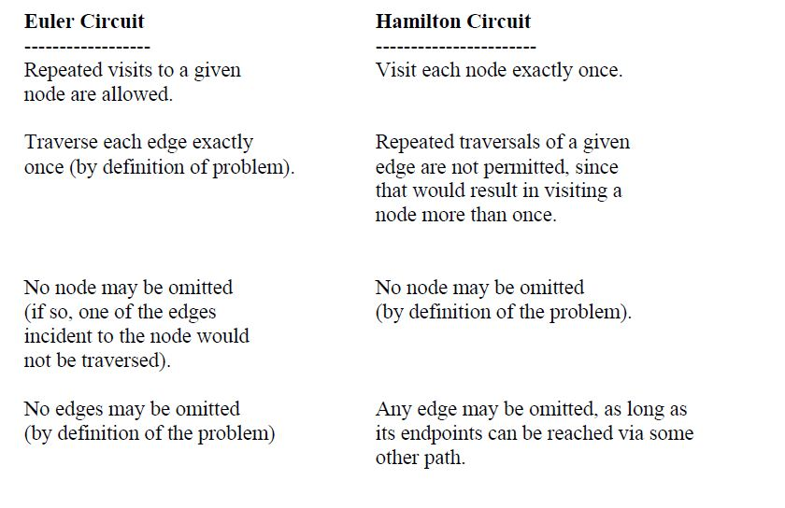
Difference Between Euler And Hamiltonian Circuit

